Slide 1
Association of Type 2 Diabetes and Its Genetic Susceptibility with the Risk of Severe COVID-19
Spring Conference 2021
Korean Statistical Society
May 28th, 2021
Department of Statistics and Actuarial Science, Soongsil University
Wonil Chung, Ph.D.

Slide 2
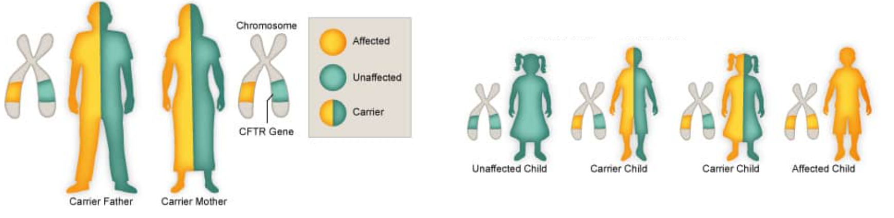
Genetic Predisposition
Genetic predisposition (also called genetic susceptibility)
Likelihood of developing a particular disease based on a person's genetic variants
Results from specific genetic variations that are often inherited from a parent
Some people with a predisposing genetic variation will never get the disease while others will, even within the same family
Can be quantified by polygenic risk scores (PRS)

Slide 3
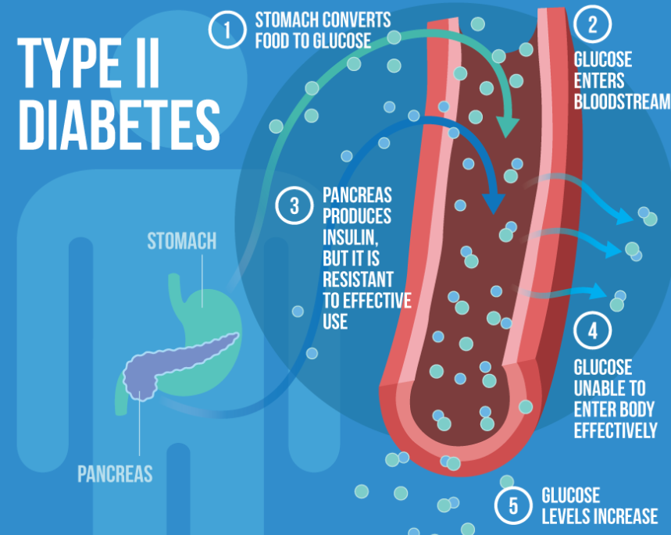
Genetic Predisposition to T2D
Relationship between the genetic predisposition for T2D and the risk of T2D
How to compute genetic risk that contributes to the development of T2D?
PRS for T2D, T2D-related traits (eg. beta-cell dysfunction for impaired insulin synthesis)
How to examine relationship between PRS and the risk of T2D?
Association of derived PRS with the risk of T2D

Slide 4
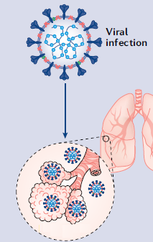
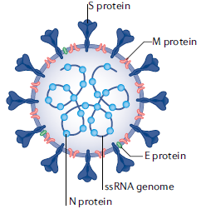
Genetic Predisposition to COVID-19
Relationship between the genetic predisposition for complex traits and the risk of developing severe COVID-19
How to estimate the genetic predisposition for complex traits?
PRS for complex traits
How to examine relationship between PRS and COVID-19?
Association of derived PRS with the risk of severe COVID-19

Slide 5
What is Genetic Risk Prediction?
Predicting disease risks in individuals based on genetic markers
Use GWAS data to predict a continuous trait (e.g. Height, BMI, Weight)
predicted genomic scores
prediction R² = cor²(predicted value, true value)
Use GWAS data to predict a case-control trait (e.g. T2D, Cancer)
predicted disease risk scores, predicted prevalence of disease
pseudo-R², R² on the liability scale (Lee et al. 2012 GenetEpi), AUC (Area Under the Curve)

Slide 6
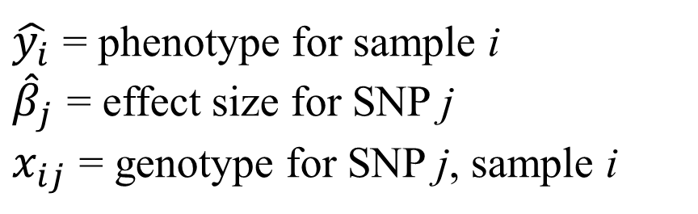
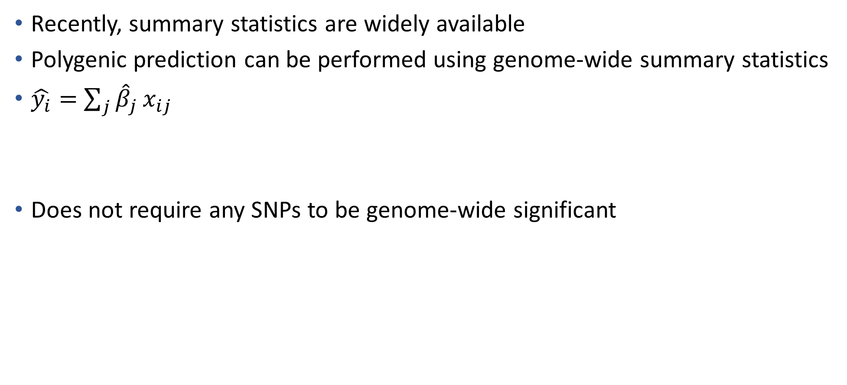
Polygenic Risk Scores using a Large Number of SNPs
Recently, summary statistics are widely available
Polygenic prediction can be performed using genome-wide summary statistics
$\hat{y_{i}}=$ $\sum_{j}{{\hat{β}}_{j}}x_{ij}$
Does not require any SNPs to be genome-wide significant
$\hat{y_{i}}$ = phenotype for sample i
${\hat{β}}_{j}$ = effect size for SNP j
$x_{ij}$ = genotype for SNP j, sample i
(all GWAS SNPs)
Purcell et al. 2009 Nature

Slide 7
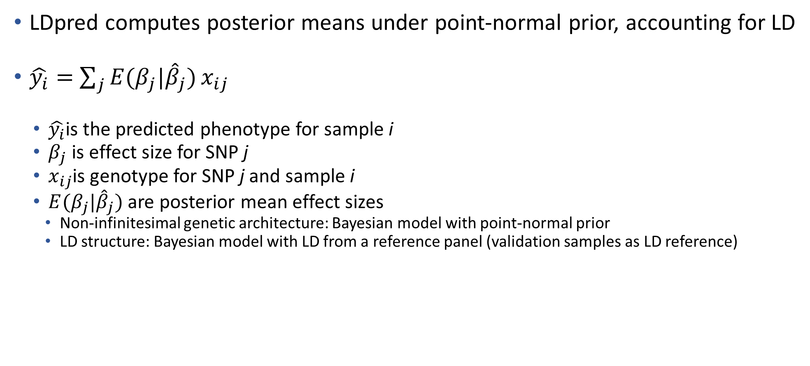
LDpred
LDpred computes posterior means under point-normal prior, accounting for LD
$\hat{y_{i}}=$ $\sum_{j}{E(β_{j}|{\hat{β}}_{j})}x_{ij}$
$\hat{y_{i}}$is the predicted phenotype for sample i
$β_{j}$ is effect size for SNP j
$x_{ij}$is genotype for SNP j and sample i
$E(β_{j}|{\hat{β}}_{j})$ are posterior mean effect sizes
Non-infinitesimal genetic architecture: Bayesian model with point-normal prior
LD structure: Bayesian model with LD from a reference panel (validation samples as LD reference)
(all GWAS SNPs)
Vilhjalmsson et al. 2015 Am J Hum Genet

Slide 8
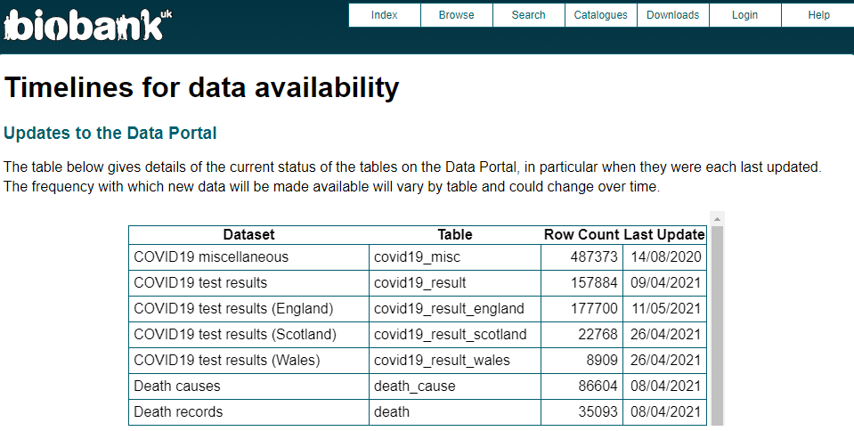
COVID-19 Data in UKB

Slide 9
COVID-19 Data in UK Biobank
COVID-19 Data in UK Biobank
Individuals with both COVID-19 positive and negative results
consider them as individuals with COVID-19 positive results
12,886 individuals have COVID-19 positive
Use of all individuals in UK Biobank
 | COVID-19 positive (case) | COVID-19 negative (control)
2020.08.02 | 1,374(0.3%) | 458,864(99.7%)
2021.02.10 | 12,886(2.8%) | 447,352(97.2%)

Slide 10
GWAS for COVID-19
GWAS using BOLT-LMM
Genotypes: UK Biobank (P=9,572,556, MAF>0.01, ImR²>0.8)
Covariates: age, age², gender, access center, genotype array, PC1-PC20
Phenotypes:
Use of individuals in COVID19 data → Case: 14,420 / Control :44,177 (Total: 59K)
Use of full UKB samples → Case: 14,420 / Control: 446K (Total: 460K)

Slide 11
GWAS for COVID-19, Ellinghaus et al. NEJM (2020)
835 cases and 1255 controls (8.9M SNPs) from Italy
775 cases and 950 controls (9,1M SNPs) from Spain (N=3815)
<locus 9q34.2>
rs657152 (OR: 1.32, P=4.95*10⁻⁸)
coincided with the ABO blood group locus
- A higher risk among persons with blood group A
- A protective effect for blood group O
<locus 3p21.31>
rs11385942 (OR: 1.77, P=1.15*10⁻¹⁰)
SLC6A20, LZTFL1, CCR9, FYCO1, CXCR6 and XCR1

Slide 12
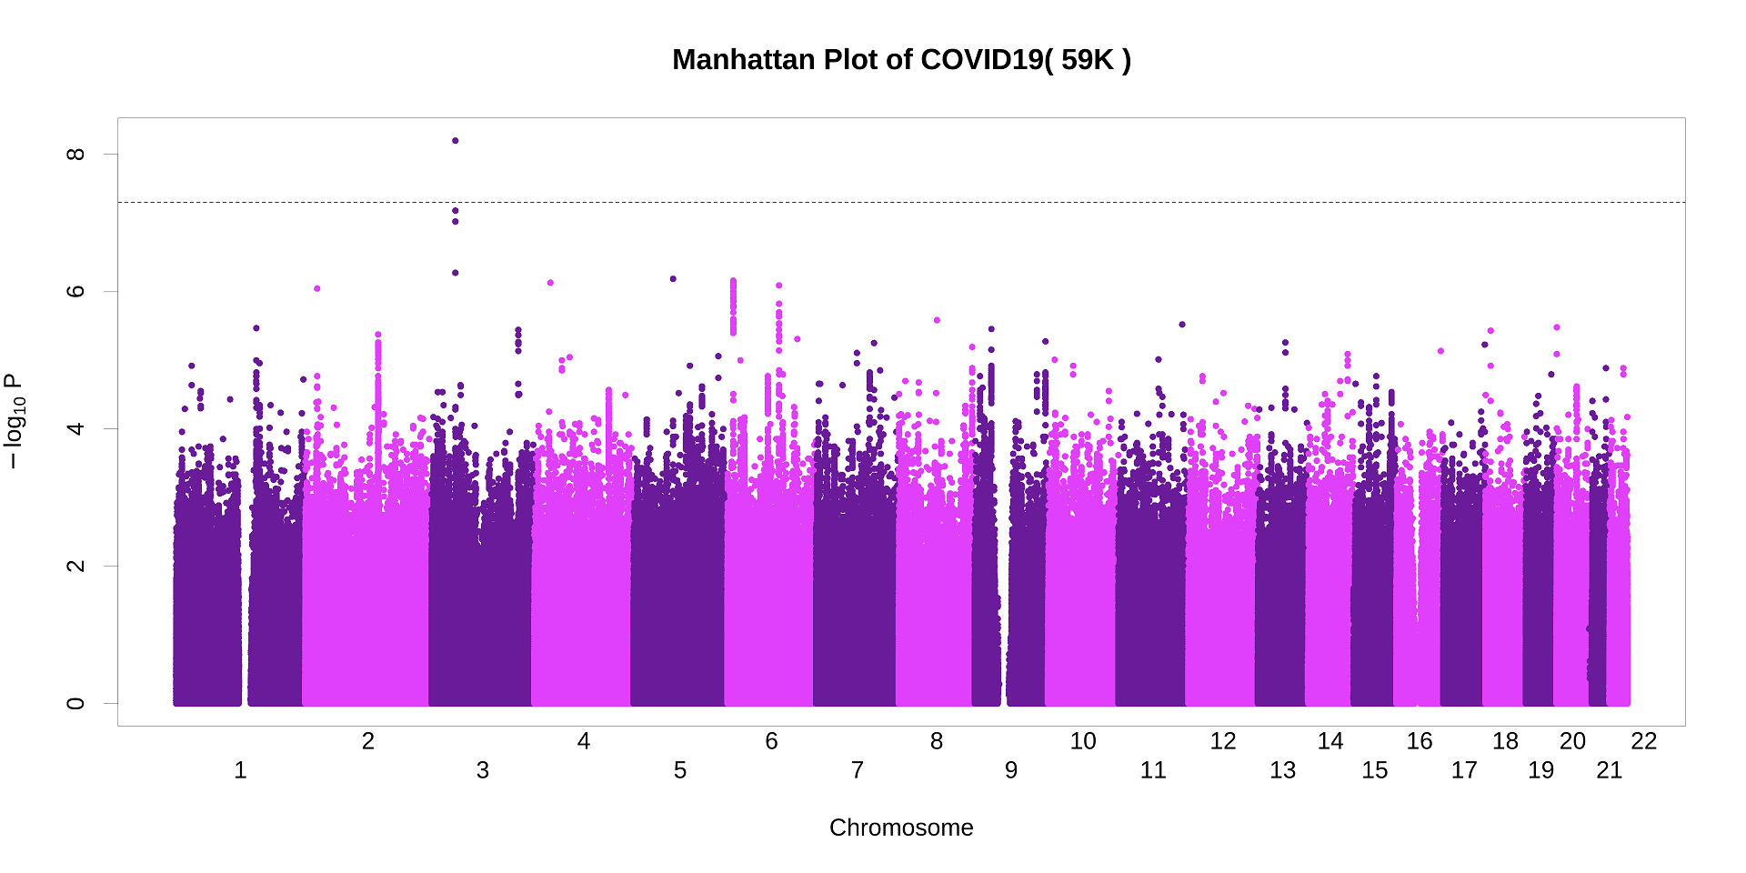
GWAS for COVID-19 (N=59K)

Slide 13
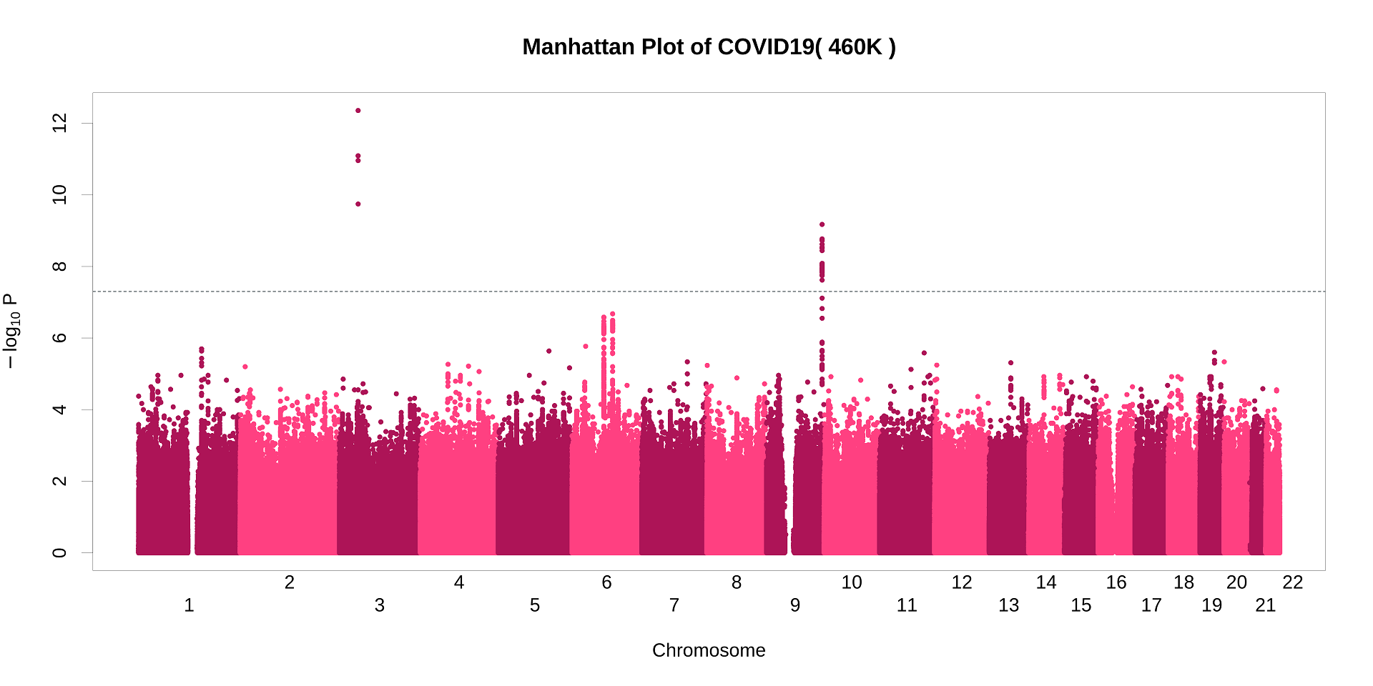
GWAS for COVID-19 (N=460K)

Slide 14
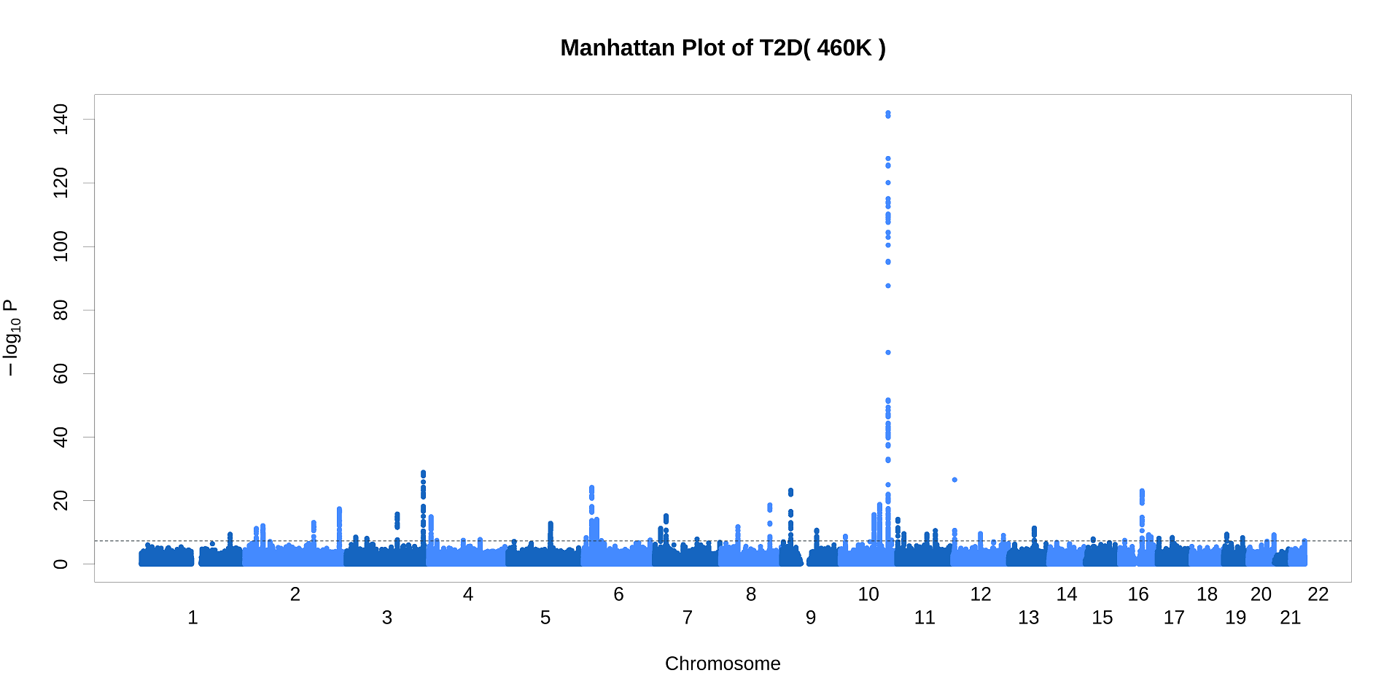
GWAS for T2D (N=460K)

Slide 15
PRS for T2D and T2D-related Traits
Obtain estimated effect sizes for T2D or T2D-related traits from UK Biobank (N=408K) using BOLT-LMM (#Case=18,219)
Apply LDpred to compute coefficients using 1.1M independent SNPs and 1000G ph3 ver5 as reference panel, ranging causal fraction from 0.001 to 1
Use 10-fold CV to compute PRS
Using an internal validation set within UK Biobank (N=40K), we selected optimal model with a causal fraction of 0.1

Slide 16
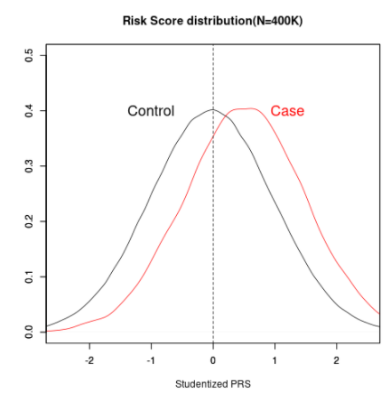
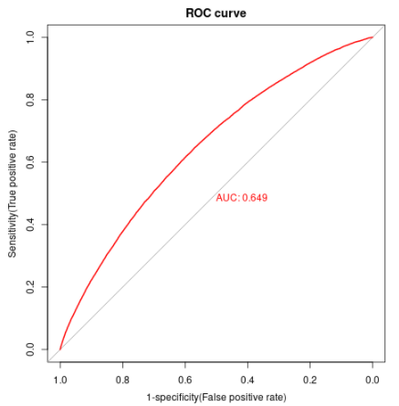
AUC and pseudo-R² for all individuals (N=408K)
AUC: 0.649, Pseudo-R²: 0.051

Slide 17
Logistic Regression with T2D
Logistic Regression models for COVID-19
Model: logit(COVID-19) ~ [Traits] + age + gender + ethnicity
[Traits]:Obesity-related traits (BMI, WST, WHR), T2D, CVD, Asthma
Traits | OR | SE | Z Score | P-value
BMI | 1.217 | 0.008 | 22.088 | 4.05*10⁻¹⁰⁸
Waist Circumference | 1.223 | 0.009 | 20.371 | 4.05*10⁻⁹²
Waist-Hip Ratio (WHR) | 1.233 | 0.011 | 17.783 | 9.48*10⁻⁷¹
T2D | 1.713 | 0.0381 | 14.132 | 2.41*10⁻⁴⁵
CVD | 1.306 | 0.029 | 8.947 | 3.64*10⁻¹⁹
Asthma | 1.206 | 0.025 | 7.488 | 7.01*10⁻¹⁴

Slide 18
Logistic Regression with PRS for T2D
Logistic Regression models for COVID-19
Model: logit(COVID-19) ~ [Traits] + age + gender, BMI + hypertension + smoking status
[Traits]: T2D, PRS(T2D)
Association of severe COVID-19 with overall genetic susceptibility for T2D
PRS (T2D) represent an individual’s overall genetic risk for T2D trait
(2021.2.10) | Controls | COVID19 Cases
Controls | 10,713 | 379,953
T2D Cases | 700 | 17,519
Traits | Covariates | OR | P-value
T2D | No | 1.417 | 1.84*10⁻¹⁸
 | Adjustment | 1.414 | 2.98*10⁻¹⁶
PRS (T2D) | No | 1.073 | 6.57*10⁻¹⁴
 | Adjustment | 1.042 | 1.86*10⁻⁰⁵

Slide 19
Death Records
Death Records in UK Biobank
Study period: 2020.3.16 ~ 2021.2.10
Total of 3,221 deaths
Mortality rate for individuals with T2D
and positive COVID-19 results is highest among other disease groups
Survival
death
2020.03.16(Initial day of study)
2021.02.10(Last day of study)
Death | Controls | COVID-19 Cases
Controls | 2,419 | 380
T2D Cases | 346 | 76
Survival | Control | COVID-19 Cases
Control | 356,511 | 10,327
T2D Cases | 13,757 | 622
Mortality Rate | Control | COVID-19 Case
Control | 2419/(2419+356511)*100=0.673% | 380/(380+10327)*100=3.549%
T2D Cases | 346/(346+13757)*100=2.453% | 76/(76+622)*100=10.888%

Slide 20
Cox Proportional Hazard Model with T2D
Multivariable Cox Proportional Hazard Models
Investigate the effect of T2D patients infected with severe COVID19 on length of survival
Response: survival time and status (0: censored, 1: death)
Explanatory variables:
Unadjusted: T2D, COVID-19
Adjusted: T2D, COVID-19, Age, Gender, BMI, Hypertension, Smoking Status
 | Covariates | HR | 95% CI | P-value
T2D | No | 3.6724 | (3.2812, 4.110) | 2.06*10⁻¹¹³
 | Adjustment | 2.0517 | (1.8202 , 2.3126) | 5.88*10⁻³²
COVID-19 | No | 5.3459 | (4.7979, 5.956) | 1.05*10⁻²⁰²
 | Adjustment | 6.276 | (5.6249, 7.0025) | 6.67*10⁻²³⁷

Slide 21
Cox Proportional Hazard Model with PRS for T2D
Multivariable Cox Proportional Hazard Models
Investigate the effect of individuals with high genetic risk for T2D infected with severe COVID19 on length of survival
Response: survival time and status (0: censored, 1: death)
Explanatory variables:
Unadjusted: PRS(T2D), COVID-19
Adjusted: PRS(T2D), COVID-19, Age, Sex, BMI, Hypertension, Smoking Status
 | Covariates | HR | 95% CI | P-value
PRS(T2D) | No | 1.098 | (1.0576, 1.1395) | 9.42*10⁻⁷
 | Adjustment | 1.064 | (1.0247, 1.105) | 1.28*10⁻³
COVID-19 | No | 5.517 | (4.9957, 6.0917) | 1.14*10⁻²⁴⁹
 | Adjustment | 6.171 | (5.5800, 6.825) | 9.29*10⁻²⁷⁵

Slide 22
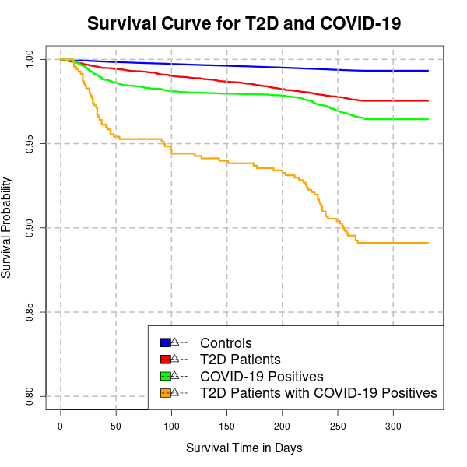
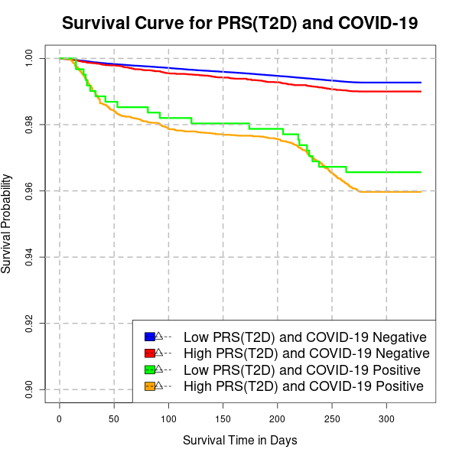
Kaplan–Meier Survival Curve

Slide 23
Summary
Individuals with T2D are at a higher risk for developing severe COVID-19
A positive association of the individual’s overall genetic risk for T2D with severe COVID-19
Indicating the roles of T2D and T2D-related genetics in the pathogenesis of severe COVID-19
T2D patients with COVID-19 positive has significantly higher motility rate than normal people with COVID-19 positive (log-rank p-values = 1.68*10⁻²²)

Slide 24
Future Research Plan
Association Studies between COVID-19 and underlying diseases
Examine association of COVID-19 with many underlying diseases such as obesity, CVD and asthma and their genetic predispositions using logistic regression models
Use of DIAGRAM consortium data to generate PRS for T2D
Causal Inference between COVID-19 and underlying diseases
Mendelian randomization methods
MR-Egger, MR-PRESSO, GSMR, LCV
Survival Analysis for COVID-19
Interaction analysis for COVID-19 and other underlying diseases
Fitting cox proportional models using deep learning algorithm such as Deepsurv

Slide 25
Thank You!

